Slide 1
Image captioning with Region-Based Attention and Scene-Specific Contexts
Submitted By
Viranchi Badheka [15IT111]
Nihar Raichada [15IT132]
Ria Kulshrestha [15IT231]
Shivani Shrivastava [15IT243]

Slide 2
Introduction
Automatically generating captions of an image is a task very close to the heart of scene understanding and one of the primary goals of computer vision.
Image captioning is a very important challenge for machine learning algorithms.
It amounts to mimicking the remarkable human ability to compress huge amounts of salient visual information into descriptive language.
Human visual system is very unique in terms of the presence of attention, which allows for salient features to dynamically come to the forefront as needed.
We implemented a model that can attend to salient part of an image while generating its caption.

Slide 3
No. | Title | Author & Publication | Technique Used | Our Inference
1. | Show and tell: A neural image caption generator | O. Vinyals, A. Toshev, S. Bengio, and D. Erhan, Proc. IEEE Conf. Comput. Vis.Pattern Recognit., 2015, pp. 3156–3164 | RNN’s used for encoding variable length input to a fixed length vector for further processing | CNN’s worked better than encoder RNN’s as they produced better description of images due to different kernels.
2. | Long-term recurrent convolutional networks for visual recognition and description | J. Donahue et.al, Proc. IEEE Comput. Vis. Pattern Recognit., 2014, pp. 2625–2634 | LSTM’s were used for caption generation | RNN’s only produced fixed length captions and has vanishing/exploding gradient problem; LSTM solves this through its architecture design
3. | Explain images with multimodal recurrent neural networks | J. Mao, W. Xu, Y. Yang, J. Wang, and A. L. Yuille, Proc. Int. Conf.Learn. Representations, 2015 | Multimodal RNN which consisted of a combination of CNN and RNN | RNN is better at language processing while CNN is better at extraction of image features. This approach combines both.

Slide 4
No. | Title | Author and Publication | Technique Used | Our Inference
4. | Show, attend and tell: Neural image caption generation with visual attention | K. Xu, et al, Proc. 32nd Int. Conf. Mach. Learn., 2015, pp. 2048–2057 | Attention based Encoder-Decoder framework using LSTM | Instead of combining an image into a static representation, assigning weights to regions and deciding the ones to use in captioning is described here.
5. | Image captioning with semantic attention | Q. You, H. Jin, Z. Wang, C. Fang, and J. Luo, Proc. IEEE Conf. Comput. Vis. Pattern Recognit., 2016, pp. 4651–4659 | Combined top-down and bottom up method for identifying semantically more important regions using RNN | Top-down approach converts visual feature vector to words and bottom-up approach assigns weights depending upon RNN iterations.
6. | Latent Dirichlet Allocation | David M. Blei, Andrew Y. Ng, Michael I. Jordan, Proc. Journal of Machine Learning research | Probabilistic modeling of topics to create a “short description” of a document | Allows sets of observations to be explained by unobserved groups that explain why some parts of the data are similar.
7. | Selective search for object recognition | J. R. Uijlings et al., Proc. Int. Journal of Computer Vision,vol. 104, no. 2, pp. 154–171, 2013 | Combines the strength of both Exhaustive search and segmentation. | Full segmentation hierarchy is accounted for and all the image segments or the tight bounding boxes around those segments are considered as potential object locations

Slide 5
No. | Title | Author | Technique Used | Our Inference
8. | Rich feature hierarchies for accurate object detection and semantic segmentation | Ross Girshick Jeff Donahue Trevor Darrell Jitendra Malik | "RCNN - Region with CNN". Consists of three modules, first generates category-independent region proposals, second is a large CNN that extracts a fixed-length feature vector from each region. Last module is a set of class specific linear SVMs. | It requires each ROI to be computed individually through the CNN as the input size for the CNN was fixed. Secondly, the training process for their architecture is a multi stage pipeline. Lastly, the training is expensive in space and time.
9. | Spatial Pyramid Pooling in Deep Convolutional Networks for Visual Recognition | Kaiming He, Xiangyu Zhang, Shaoqing Ren, Jian Sun | Replaces the last pooling layer with a spatial pyramid pooling layer to project region proposals of arbitrary sizes to fixed-length feature vectors. | Input image can be of any sizes and allow arbitrary aspect ratios and arbitrary scales. The conv layers preceding the SPP layer cannot be updated with the fine-tuning algorithm.

Slide 6
No. | Title | Author | Technique Used | Our Inference
10. | Fast R-CNN | Ross Girshick | A fixed-length feature vector is extracted from each region proposal with a region of interest (RoI) pooling layer. | Training of all network layers can be processed in a single-stage with a multi-task loss. It saves the additional expense on storage space, and improves both accuracy and efficiency.
11. | Faster R-CNN: Towards Real-Time Object Detection with Region Proposal Networks | Shaoqing Ren, Kaiming He, Ross Girshick, Jian Sun | Introduced an additional Region Proposal Network(RPN). It shares full-image conv features with detection network. | RPN operates on a specific conv layer with the preceding layers shared with object detection network. Can be fully trained in an end-to-end way. Removes bottleneck of ROI generation.
12. | Learning from LDA using Deep Neural Networks | Dongxu Zhang , Tianyi Luo , Dong Wang , Rong Liu | The proposed method includes transfer learning with 2 hidden layers in the DNN model. | LDA using 2 hidden layers gives reasonable accuracy and significantly reduces computation time as compared to gensim’s LDA

Slide 7
No. | Title | Author | Technique Used | Our Inference
13. | R-FCN: Object Detection via Region-based Fully Convolutional Networks | Jifeng Dai, Yi Li, Kaiming He, Jian Sun | Designed to classify the RoIs into object categories and background. RoI is divided into k x k bins and each of the k × k bin aggregates responses from only one score map out of the bank of k × k score maps. | Considers the translation variance. It ends with a position-sensitive RoI pooling layer.
14. | Feature Pyramid Networks for Object Detection | Tsung-Yi Lin, Piotr Dollar, Ross Girshick, Kaiming He, Bharath Hariharan, and Serge Belongie | Uses pyramid of the same image at different scales to detect objects. composes of a bottom-up and a top-down pathway. | Lateral connections are added between reconstructed layers and the corresponding feature maps to help the detector to predict the location better.

Slide 8
Problem Statement and Objectives
To model an image captioning system with region-based attention and scene-specific contexts
Objectives:
To generate localized candidate regions at multiple scales, which contain visually salient objects, to represent images.
To build an LSTM-based neural network that models the attention dynamics of focusing on those regions as well as generating the words sequentially.
To extract scene-related global contexts, followed by injecting scene contexts into LSTMs.
To integrate individual components and evaluate the results using the Bleuscore metric on MS-COCO dataset.

Slide 9
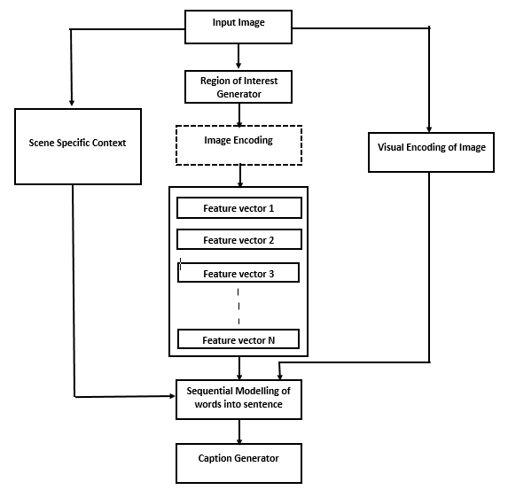
Detailed Design and Methodology

Slide 10
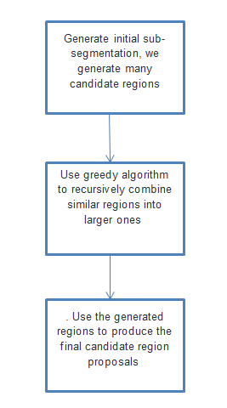
Selective Search
Problems with Selective Search:
Can’t be implemented in real time as it takes around 47 seconds for each test image.
The selective search algorithm is a fixed algorithm. Therefore, no learning is happening at that stage. The two models are decoupled.
Would have to classify 2000 region proposals per image.

Slide 11
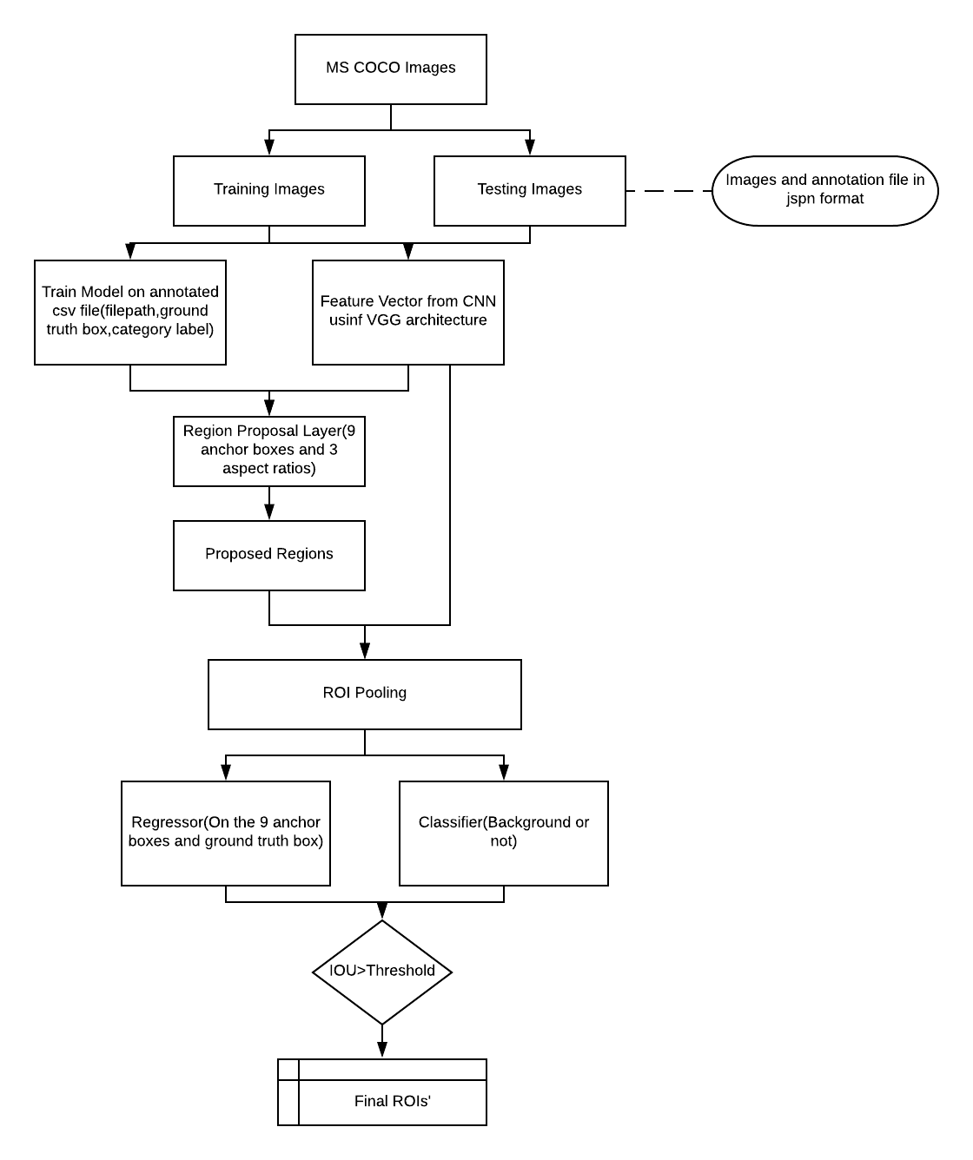
FRCNN Flow Diagram

Slide 12
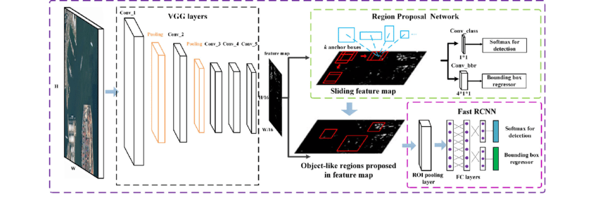
FRCNN Architecture Diagram Source: From Research Gate by Zhipeng Deng/

Slide 13
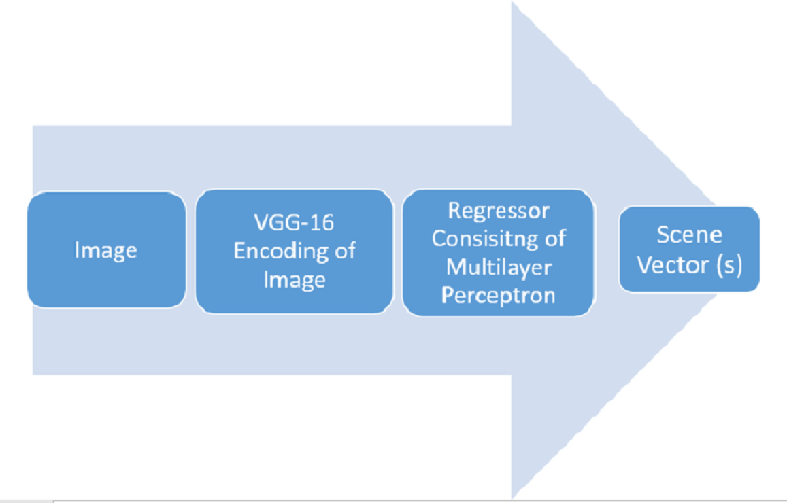
LDA Flow Diagram: The regressor shown consists of the multilayered perceptron trained on the scene vectors obtained from captions.txt of the MSCOCO dataset using LDA.

Slide 14
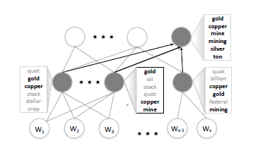
LDA using Deep Neural Network Source:

Slide 15
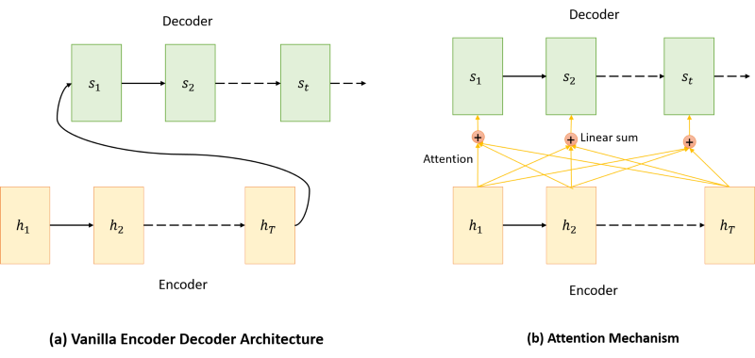
RNN model Vs. RNN with attention mechanism.
Source: Medium blog post by Shashank Yadav

Slide 16
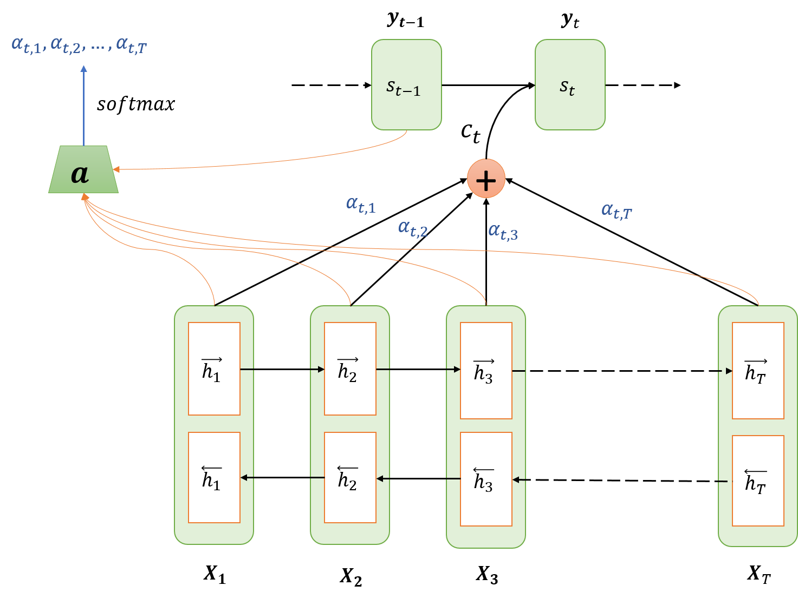
Attention Mechanism Architecture.
Source: Medium blog post by Shashank Yadav

Slide 17
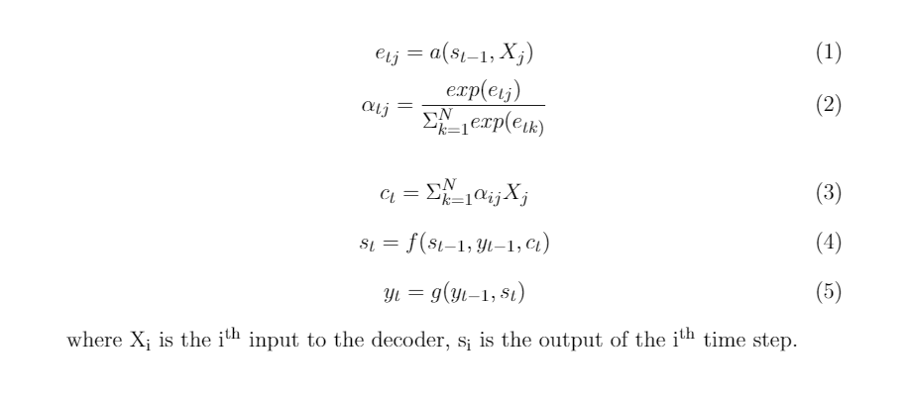
Equations of RNN with attention mechanism.

Slide 18
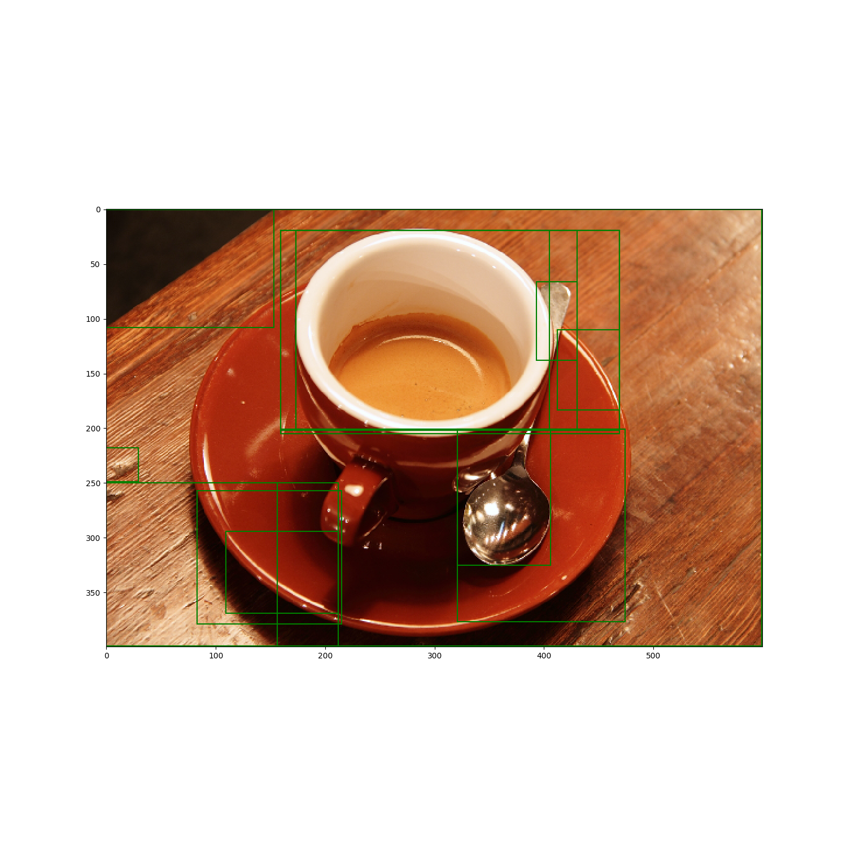
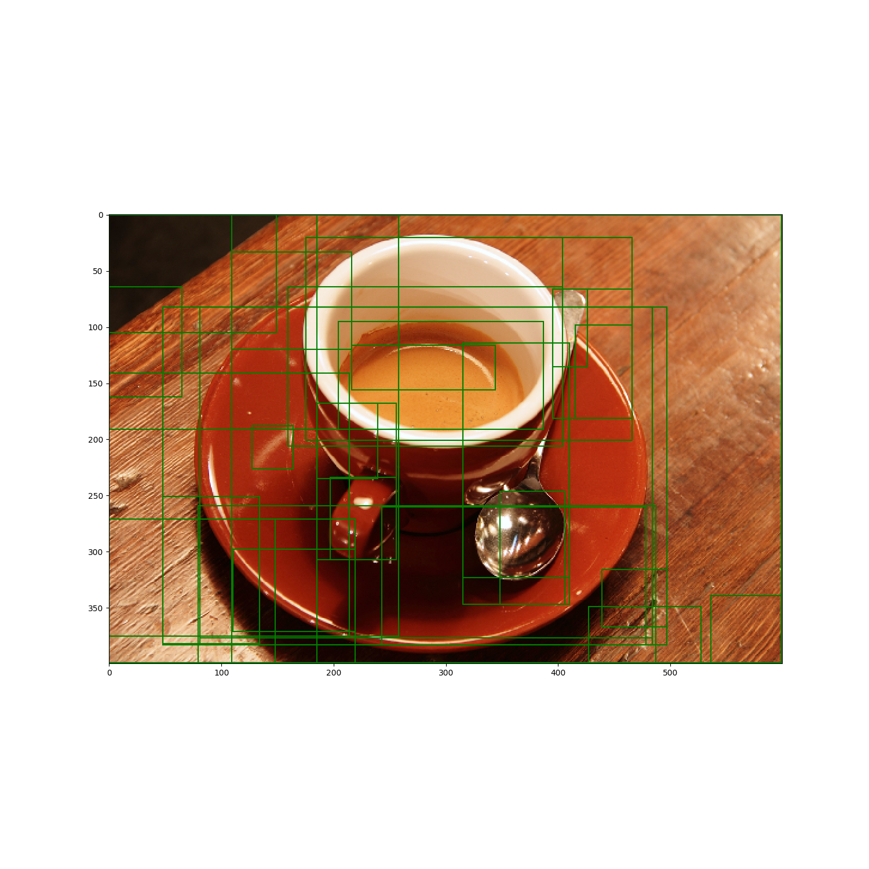
Results and Analysis
Bounding Boxes Using Selective Search
K (scaling coefficient) = 1300
K (scaling coefficient)= 700

Slide 19
Results and Analysis
Latent Dirichlet Allocation

Slide 20
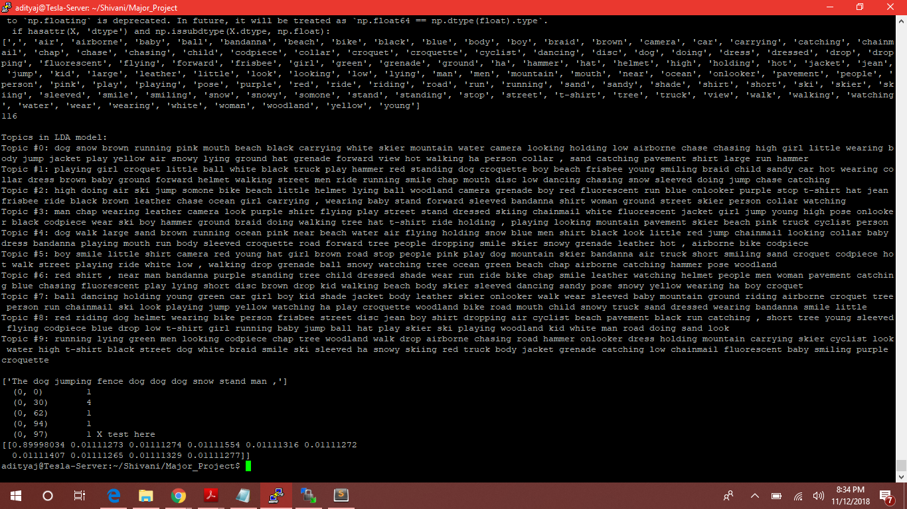
Latent Dirichlet Allocation
Probability distribution for number of topics = 10 on the package scikit-learn
Notes:
#Topics 10 changed the input x to see effect on the topic distribution

Slide 21
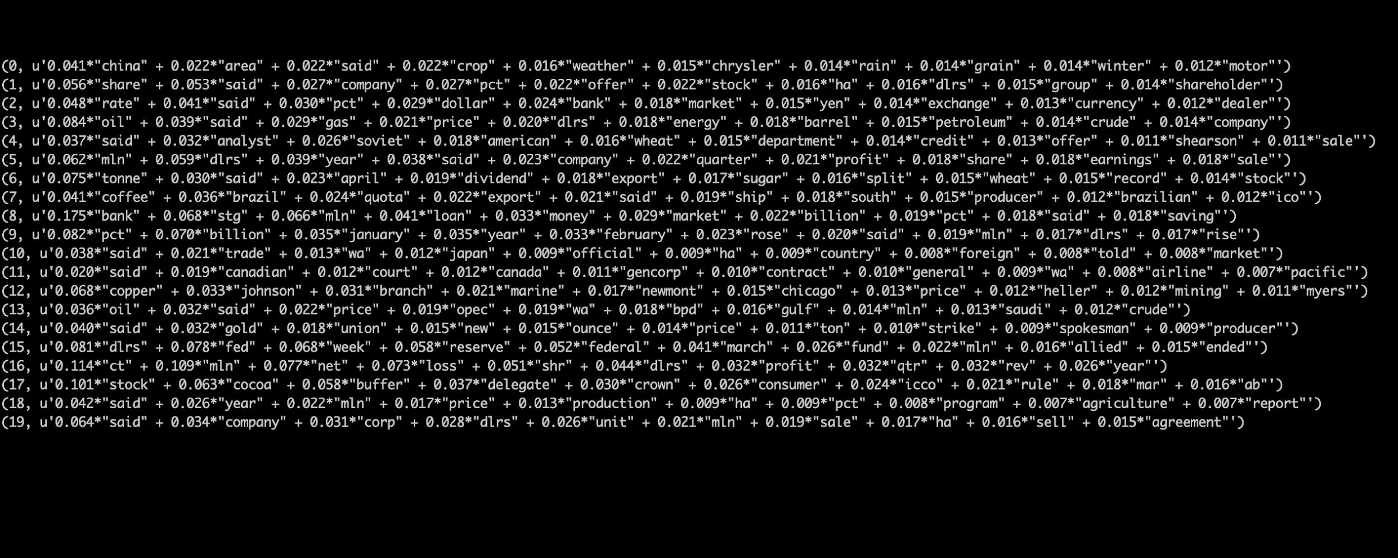
LDA with deep neural networks
Topic modelling for topics = 20 with 2 hidden layers and 1 output layer

Slide 22
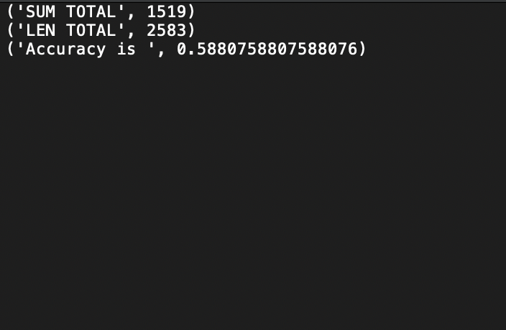
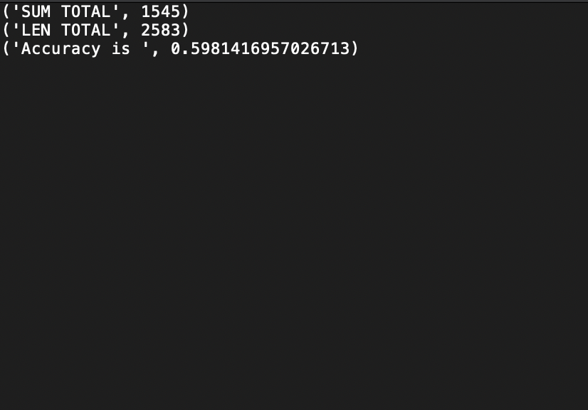
Accuracy of a 3NN model vs LDA model

Slide 23
Results and Analysis
RoIs using FRCNN

Slide 24
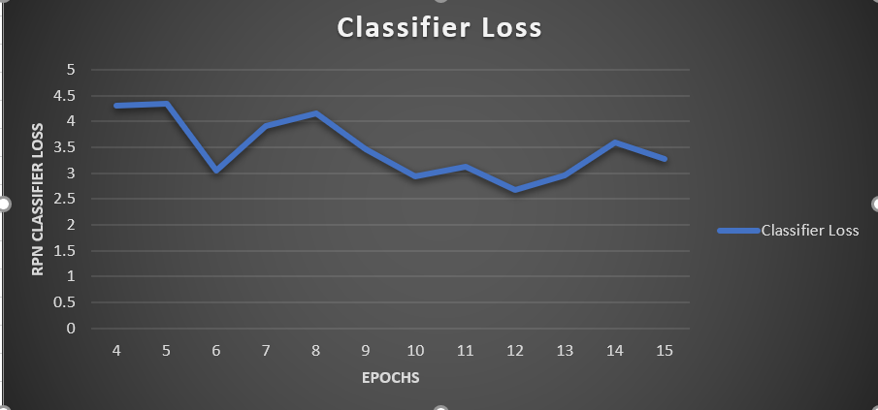
RPN Classifier Loss

Slide 25
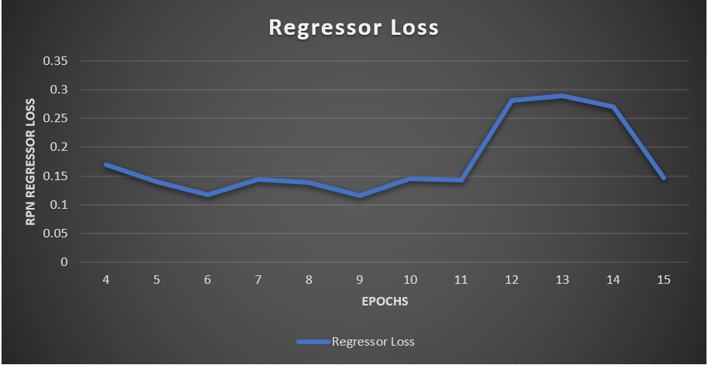
RPN Regressor Loss

Slide 26
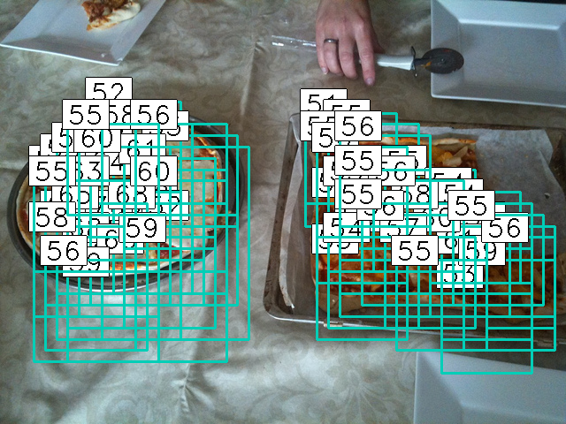
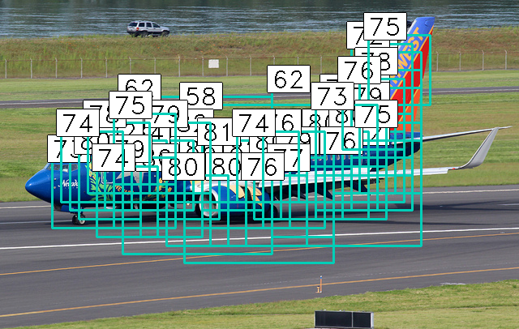
Sample Outputs for RoI

Slide 27
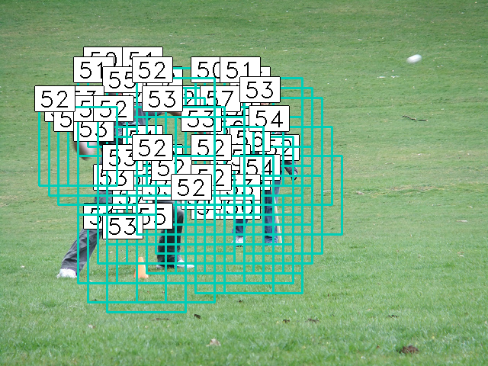
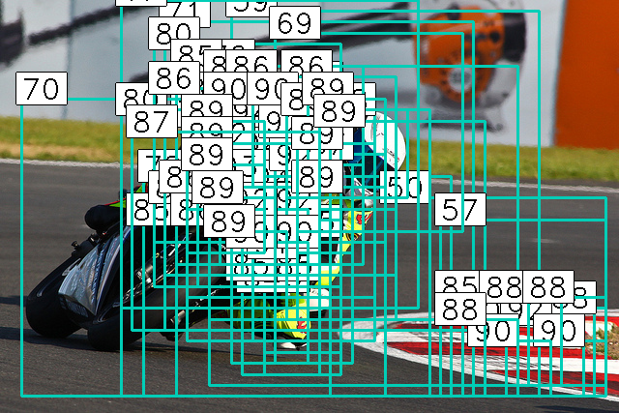

Slide 28
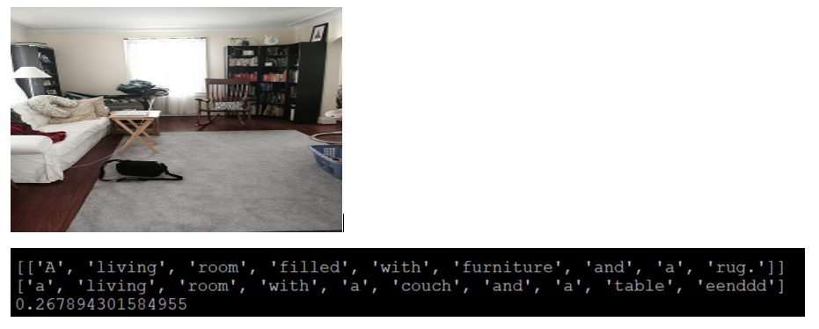
Sample outputs for captions

Slide 29
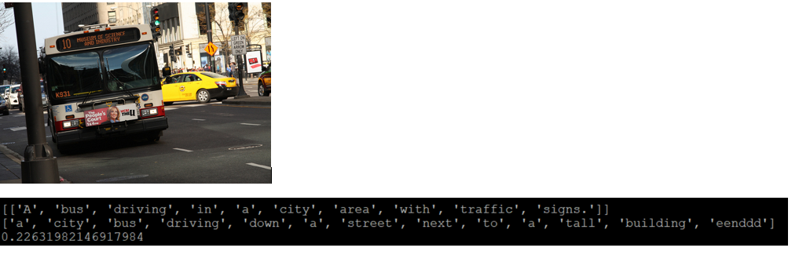

Slide 30
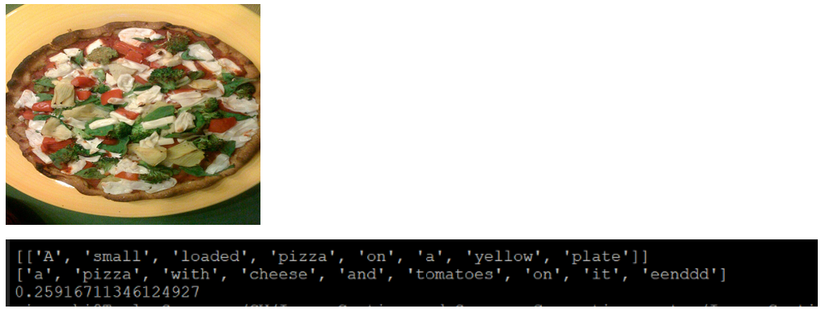

Slide 31
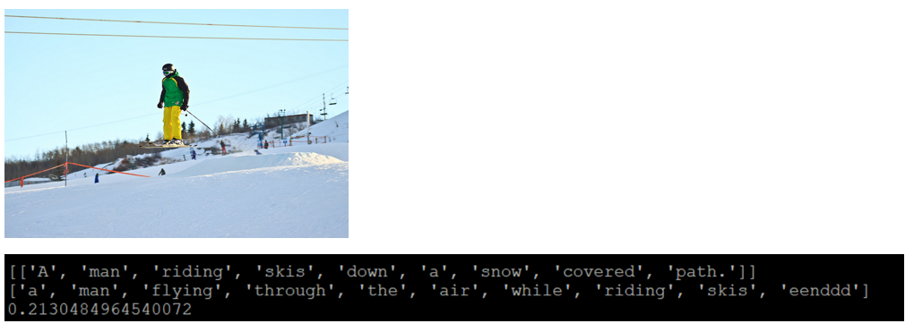

Slide 32
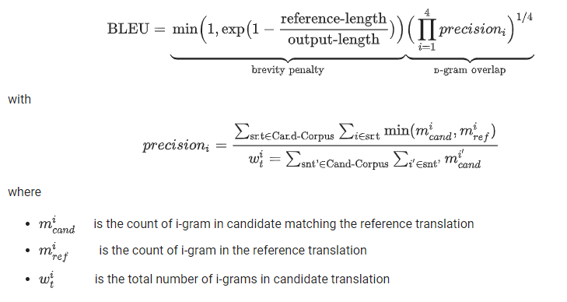
BLEU (BiLingual Evaluation Understudy) score

Slide 33
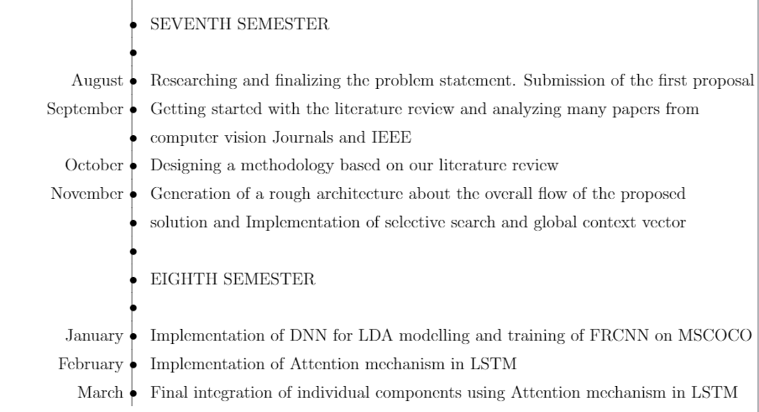
Timeline of the project

Slide 34
Individual Contribution
Viranchi - Generation of localized regions at multiple scales + representation of the generated images as a collection of visual feature vectors + LDA+ final integration and evaluation.
Nihar - Generation of localized regions at multiple scales + representation of the generated images as a collection of visual feature vectors + LDA + final integration and evaluation.
Ria - Building an LSTM-with Attention mechanism + Region of Interest generation using FRCNN+ final integration and evaluation.
Shivani - Building an LSTM-with Attention mechanism + Region of Interest generation using FRCNN+ final integration and evaluation.

